Slide 1
Advance Selectors
Universal Selector | Multiple Selector | Child Selector | Sibling Selector | Attribute Selector | Pseudo-element selector
Notes:
Welcome to out lecture on advance css selectors. In this lecture we will go through Universal Selector, Multiple Selector, Child Selector, Sibling Selector, Attribute Selector, and Pseudo-element selector. Let’s start our lecture.

Slide 2

Universal and Multiple Selector
Universal Selector: Matches all elements using asterisk (*). Ex: * { margin: 0; }.
Implied Usage: Universal selector is implied when an element name is not specified. Ex: .highlight matches the same as *.highlight.
Multiple Selector: Matches multiple elements separated by a comma. Ex: ol, ul { margin: 0; }.
Efficiency: Reduces repetition by combining selectors for shared styles.
Notes:
The universal selector, denoted by an asterisk, targets all elements in a webpage. It is often implied when no specific element is named. For example, asterisk highlight and highlight achieve the same result. The multiple selector uses a comma to apply styles to multiple elements simultaneously, improving efficiency by combining selectors. For instance, OL, UL with margin equal to 0 applies styles to both lists.

Slide 3
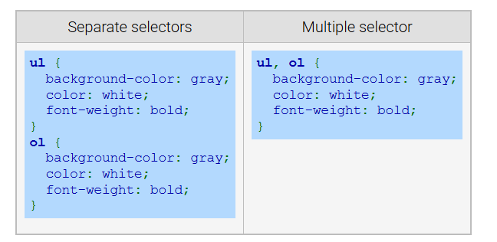
Example
Notes:
This example shows that using separate selectors for styling UL and OL can result in repetitive code. Instead, the multiple selector simplifies this by combining them with a comma. For example, UL, OL with background color as gray and color as white font weight as bold applies the same styles to both. This method improves efficiency, reduces redundancy, and keeps the CSS code cleaner and easier to maintain.

Slide 4
Child Selector
Child Selector: Uses > to target direct child elements.
Example: div > p { color: red; } applies only to p elements directly inside a div.
Difference: Unlike the descendant selector, it matches only direct children, not all nested elements.
Notes:
Next comes the child selector that targets direct child elements using the greater than symbol. For example, DIV greater than p with color as red applies styles only to p elements that are direct children of a div. Unlike the descendant selector, it does not apply styles to all nested elements, ensuring precise targeting. This helps in maintaining clarity and structure in CSS styling for specific parent-child relationships.

Slide 5
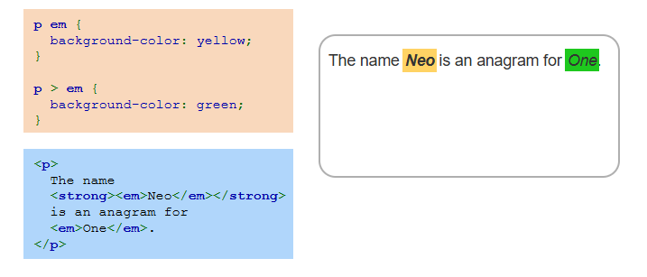
Child Selector Example
Notes:
The example here illustrates the child selector that targets direct child elements. p greater than EM applies styles only to EM elements directly inside a p tag, making their background green. The selector p EM without greater than symbol applies to all EM elements nested in a p tag, resulting in a yellow background. This distinction ensures precise styling by differentiating between direct children and all descendants within an element.

Slide 6
Sibling selector
Sibling Elements: Share the same parent element.
General Sibling Selector: Uses tilde symbol (~) to match elements after a sibling.
Example: h1 ~ p { color: blue; } applies to p elements after an h1.
Notes:
Now we will discuss the sibling selector that targets elements that share the same parent. The general sibling selector, represented by tilde, matches elements occurring after a specified sibling. For example, H1 tilde p applies styles to all p elements following an h1 within the same parent. This selector allows for styling related elements based on their sibling relationship in the document structure.

Slide 7
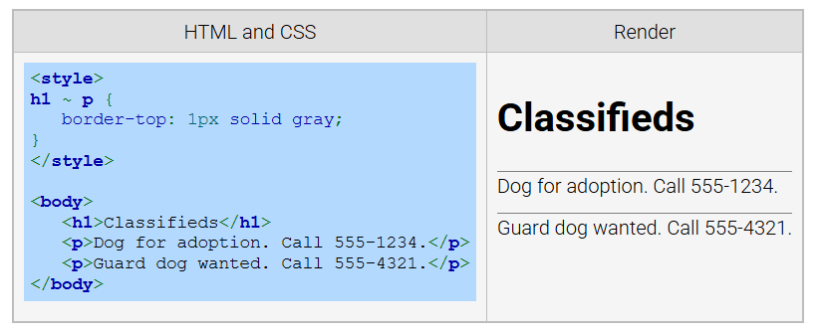
Example
Notes:
The general sibling selector uses the tilde symbol to match elements that share the same parent and appear after a specified sibling. In this example, the CSS rule h1 tilde p adds a top border to all paragraph elements that follow an H1 element in the document. This selector is useful for styling sibling elements with a shared parent without targeting them individually.

Slide 8
Adjacent Sibling selector
Adjacent Sibling: Matches an element immediately following another sibling.
Selector Syntax: Uses + between selectors.
Example: h1 + p targets a <p> directly after an <h1>.
Notes:
Move on to the adjacent sibling selector that targets an element that immediately follows another sibling element and shares the same parent. It is specified using the plus symbol. For example, the selector H1 plus p applies styles to a paragraph element that directly follows an H1 element. This selector is useful for applying styles to specific elements based on their immediate sibling relationships.

Slide 9
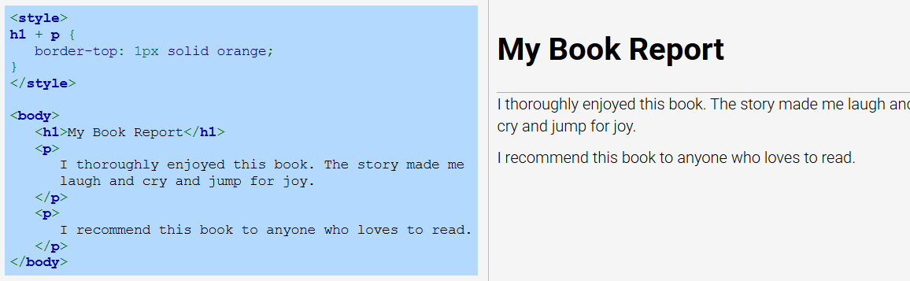
Example
Notes:
In this example the adjacent sibling selector h1 plus p styles a paragraph that directly follows an H1 element. In the code, the style adds an orange top border to any paragraph immediately after an H1 heading. This selector ensures precise styling for elements based on their immediate sibling relationships, making it ideal for enhancing specific parts of content while maintaining structural clarity.

Slide 10
Attribute Selector
Attribute Selector: Matches elements with a specified attribute.
Syntax: [attribute] or [attribute=value] for specific values.
Example: a[target="_blank"] matches links with target="_blank".
Notes:
The attribute selector targets elements with specific attributes. Use attribute to match elements with a given attribute or attribute with value for exact matches. For example, A target equal to blank applies styles to links that open in a new tab. Attribute selectors are versatile, allowing precise control over element styling based on their attributes and values.

Slide 11
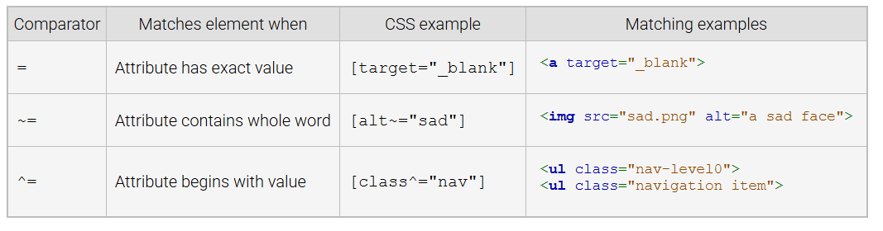
Common Attribute Selector Comparators
Notes:
Attribute selectors use comparators to match elements based on attributes. The equal comparator matches an exact value, e.g., target= under score blank. The tilde equal comparator matches when the attribute contains a whole word like ALT equal to sad. The caret equal comparator matches attributes that begin with a value like class caret equal to nav. These tools allow precise CSS styling based on attribute values.

Slide 12
Pseudo-element selector
Pseudo-element Selector: Matches parts of elements like text portions.
Uses: Styles first line, first letter, or selected text.
Example: ::before or ::after inserts content before or after an element.
Note: Double colon (::)
Notes:
Finally, we will explore the pseudo element selector allows targeting parts of elements, such as text portions. It is useful for styling specific sections like the first line, first letter, or selected text. Examples include double colon before and double colon after, which add content before or after an element. These selectors help enhance design flexibility by applying unique styles to specific text portions or adding decorative content.

Slide 13
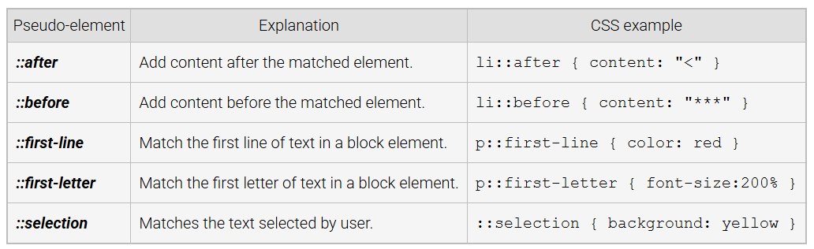
Common Pseudo-Element Selectors
Notes:
The table explains common pseudo element selectors in CSS. The double colon selector is used to style parts of elements. For example, double colon after adds content after an element, and double colon before adds content before an element. Other examples include double colon first-line for the first line of text and double colon selection for styling user-selected text. Thanks for watching the lecture.

